Slide 1
Trees (10.1)
Discrete Mathematics

Slide 2
TREE
DEFINITION : A tree is a connected undirected graph with no simple circuits.
A tree cannot have a simple circuit.
A tree cannot contain multiple edges or loops.

Slide 3
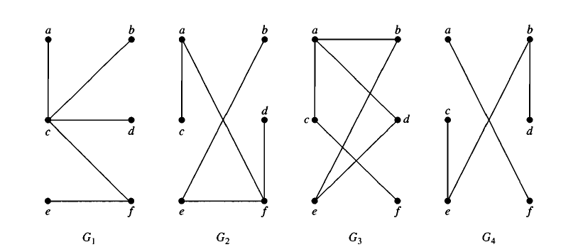
Example
Which of the graphs shown in following Figure are trees?

Slide 4
Forest
Any connected graph that contains no simple circuits is a tree.
What about graphs containing no simple circuits that are not necessarily connected?
These graphs are called forests.
Each of their connected components is a tree.

Slide 5
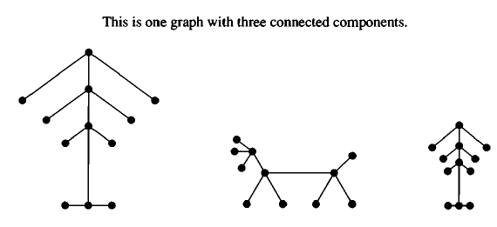
Example

Slide 6
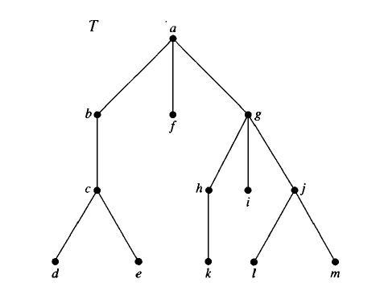
Rooted tree
A rooted tree is a tree in which one vertex has been designated as the root and every edge is directed away from the root.

Slide 7

The terminology of trees
In the rooted tree T (with root a) shown in Figure , find the following vertices.
The parent of c,
The children of g,
The siblings of h,
All ancestors of e,
All descendants of b,
All internal vertices, and
All leaves.
What is the subtree rooted at g?

Slide 8
The terminology of trees
Parent
Suppose that T is a rooted tree. If v is a vertex in T other than the root, the parent of v is the unique vertex u such that there is a directed edge from u to v.
Child If u is the parent of v, then v is called a child of u.
Siblings Vertices with the same parent are called siblings.
Internal Vertices Vertices that have children are called internal vertices.
The root is an internal vertex, unless it is the only node in the tree, in which case it is a leaf

Slide 9
The terminology of trees
Ancestors The ancestors of a vertex, other than the root, are the vertices in the path from the root to this vertex, excluding the vertex itself and including the root.
Descendants The descendants of a vertex v are those vertices that have v as an ancestor.
Leaf A vertex of a tree is called a leaf if it has no children.

Slide 10
Properties of trees

Slide 11
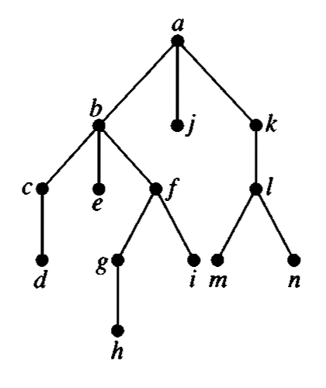
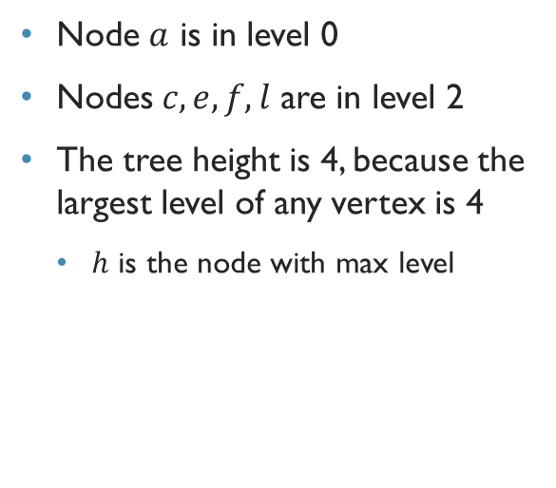
Height of tree and level of nodes
Node $a$ is in level 0
Nodes $c,e,f,l$ are in level 2
The tree height is 4, because the largest level of any vertex is 4
$h$ is the node with max level

Slide 12
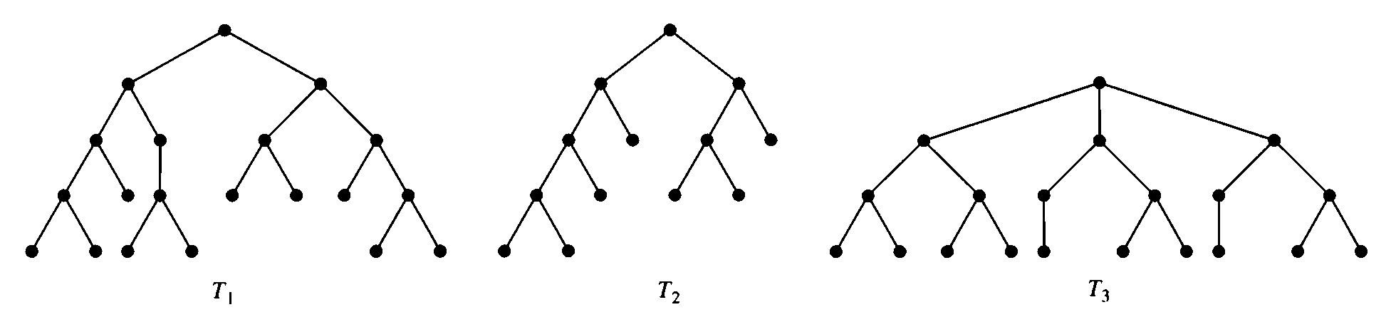
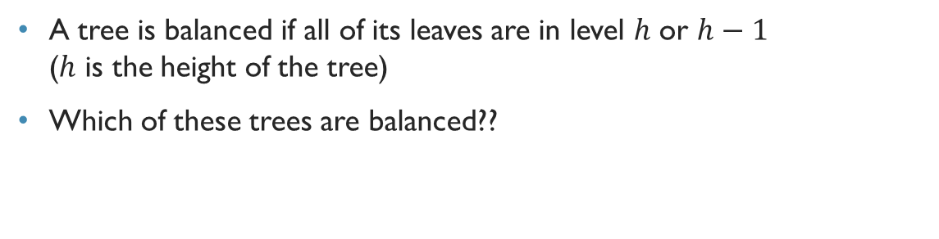
Balanced tree
A tree is balanced if all of its leaves are in level $h$ or $h−1$ ($h$ is the height of the tree)
Which of these trees are balanced??

Slide 13

Theorem 2
A tree with $n$ vertices has $n−1$ edges.

Slide 14
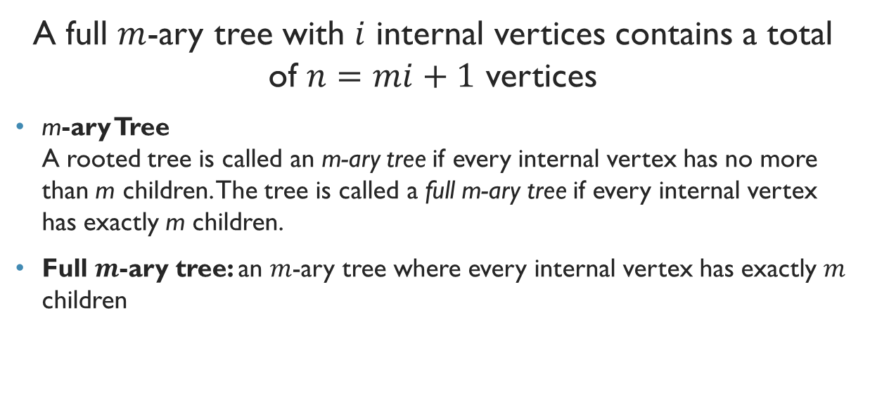
Theorem 3
A full $m$-ary tree with $i$ internal vertices contains a total of $n=mi+1$ vertices
m-ary Tree A rooted tree is called an m-ary tree if every internal vertex has no more than m children. The tree is called a full m-ary tree if every internal vertex has exactly m children.
Full $m$-ary tree: an $m$-ary tree where every internal vertex has exactly $m$ children

Slide 15
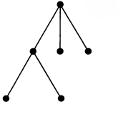
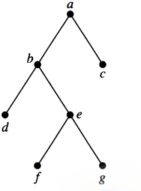
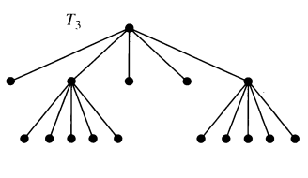
Example

Slide 16
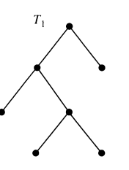
Binary Tree Ordered Rooted Tree
Binary Tree An m-ary tree with m = 2 is called a binary tree.
Ordered Rooted Tree An ordered rooted tree is a rooted tree where the children of each internal vertex are ordered.
Left and Right Child In an ordered binary tree, the first child is called the left child and the second child is called the right child.
Left and Right Subtree The tree rooted at the left child is called the left subtree and the tree rooted at the right child is called the right subtree.

Slide 17

Theorem 4
A full $m$-ary tree with $i$ internal vertices contains a total of $l=\left(m−1\right)i+1$ leaves

Slide 18
Example
Calculate the number of vertices in a full 5-ary tree with 35 internal vertices.
Also, find out the number of leaves.

Slide 19
Example
Calculate the number of vertices in a full 5-ary tree with 35 leaves.
Also, find out the number of internal vertices.

Slide 20

Theorem 5
An $m$-ary tree of height $h$ has at most $m^{h}$ leaves

Slide 21
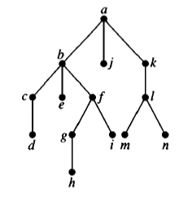
Example

Slide 22
Practice problem
Exercise- 2,3,4,5,9,17,18,19,20

